Slide 1
SIMPLE CALCULATOR USING SWINGS
GUIDED AND MENTORED BY : PUNEETHA MAHADEVAPPA

Slide 2
INTRODUCTION
Overview:
The project involves creating a simple calculator application using Java Swing.
Swing is used to create the graphical user interface (GUI) for the application.
Objective:
Develop a user-friendly calculator with a clean and intuitive interface.
Gain hands-on experience with Java Swing for building desktop applications.
Demonstrate understanding of event handling and layout management in Java Swing.
Technology Used:
Java Swing: A part of Java Foundation Classes (JFC) used for building GUIs.
IDE: Any Integrated Development Environment like Eclipse, IntelliJ IDEA, or NetBeans can be used for development.

Slide 3
Design and Components
Architecture:
MVC Design Pattern:
Model: Manages the data and logic (not heavily used in this simple application).
View: Represents the calculator's GUI (JFrame, JPanel, etc.).
Controller: Handles user input and updates the view (ActionListeners).
Components:
JFrame: - Main window of the application.
SimpleCalculator extends JFrame, making it the main window of the application.
setTitle("Simple Calculator") sets the title of the window.
setSize(400, 500) sets the size of the window.
setDefaultCloseOperation(JFrame.EXIT_ON_CLOSE) ensures the application exits when the window is closed.
setLayout(new BorderLayout()) sets the layout manager for the frame.

Slide 4
JPanel:
Container to organize components.
Used to arrange buttons and display.
JButton:
Represents the calculator buttons (numbers, operations).
topPanel = new JPanel() and panel = new JPanel() create panels to organize buttons.
panel.setLayout(new GridLayout(6, 4, 10, 10)) sets a grid layout for the main panel.
topPanel.setBackground(Color.BLACK) and panel.setBackground(Color.BLACK) set the
background color of the panels.
button.setFont(new Font("Arial", Font.PLAIN, 18)) sets the font of the button text.
button.setBackground(Color.DARK_GRAY) and button.setForeground(Color.CYAN)
set the background and text color of the buttons

Slide 5
JTextField: Displays area for input and results.
display = new JTextField() creates a text field to display input and results.
display.setFont(new Font("Arial", Font.PLAIN, 24)) sets the font of the text in the display.
Interaction Flow:
User clicks a button (JButton).
ActionListener captures the event.
Controller processes the input and updates the display (JTextField).

Slide 6
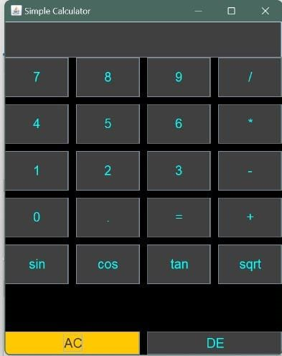
Output:
JFrame
JTextField
JButton
JButton

Slide 7
Thank you
Presented By:
Shreya Shreevalli
Shreyas P Rayas
Sneha Prakash
Sumanth DP
Ujwal HM
Vinayak

